Slide 1
WELCOME

Slide 2
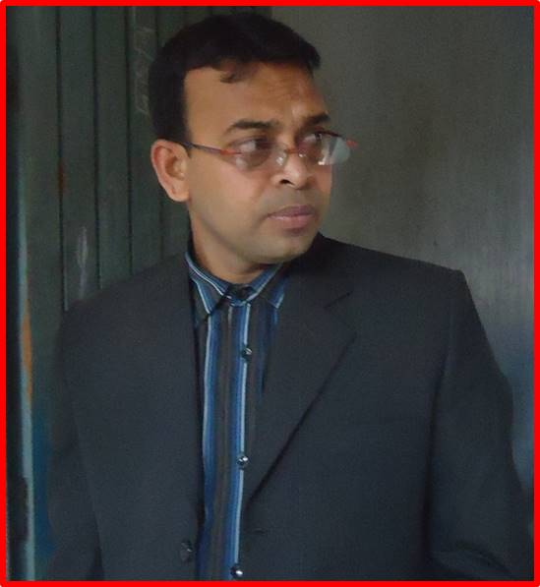
MD. KAMRUZZAMAN
SENIOR ASSISTANT TEACHER (Eng)
MUNSHIGANJ ACADEMY
ALAMDANGA, CHUADANGA
Moble No. 01916669760
E-mail : zamanlincoln@gmail.com

Slide 3
CLASS : 9/10
SUBJECT | : ENGLISH 1st Paper
UNIT | : 7
LESSON | : 1
TIME | : 50 MINUTES

Slide 4
LEARNING OUTCOME
By the end of the lesson, students will be able to-
a) learn new words
tell about the biography of Zainul
Abedin
c) describe the remarkable works of
Zainul Abedin

Slide 5
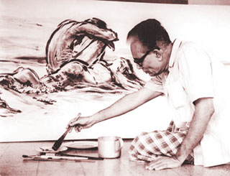
Look at the picture and say who he is

Slide 6
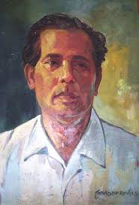
Zainul Abedin, The great artist
TODAY’S LESSON

Slide 7
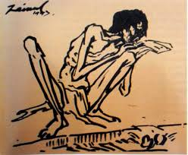
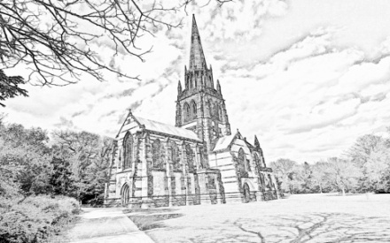
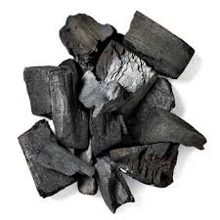
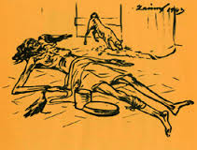
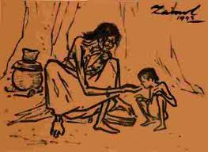
What do you see in the pictures ?

Slide 8
Famine
WANT OF FOOD
Sketch
DRAWING PICTURE
Charcoal
BLACK ASH
PASS THE DAYS IN HUNGER
Starvation

Slide 9
Individual Work
What is famine? Write.

Slide 10
Biography of Zainul Abedin at a glance
Born 0n 29th December 1914
Graduated from Calcutta Art school
The Principal of the first Art school in Dhaka
His famous painting is Manpura
Died on 28th May, 1976
Got Governor’s Gold Medal

Slide 11
Pair Work
Write the Birth date, death date and the name of most famous painting of Zainul Abedin.

Slide 12
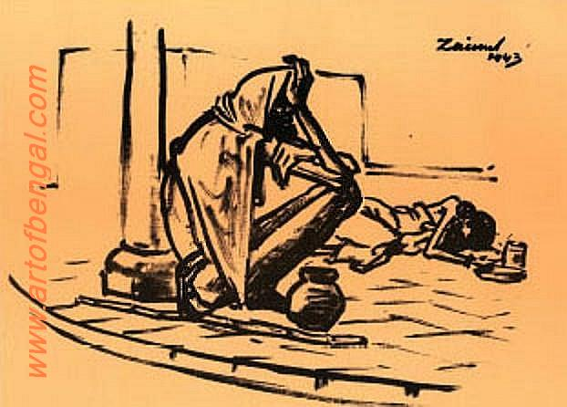
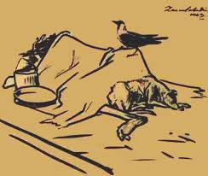
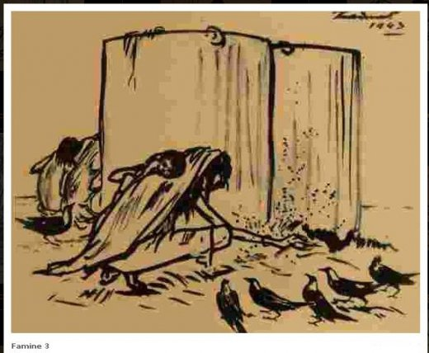
Remarkable Paintings of Zainul Abedin
Famine In 1940

Slide 13
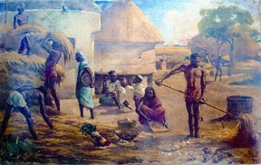
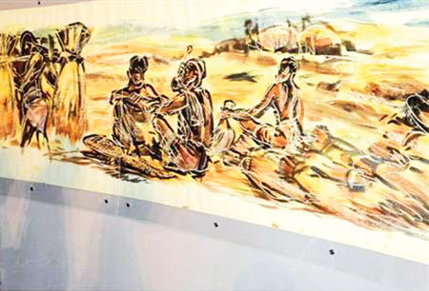
Nabanno Utshob

Slide 14
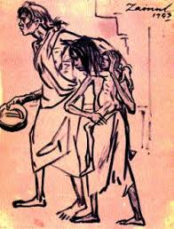
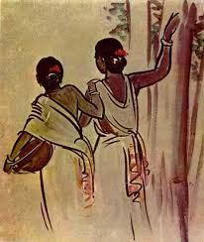
Others

Slide 15
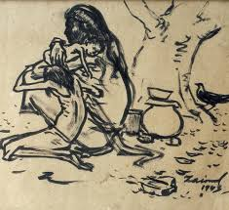
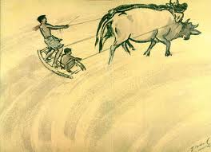
Pair Work
Describe the pictures in pairs

Slide 16
Group Work
List the remarkable paintings of Zainul Abedin

Slide 17
Evaluation
Zainul Abedin was born in.............
When did he draw the picture of famine ?
His most famous painting is........

Slide 18
HOME WORK
Write a short note on “Zainul Abedin, the great artist ”

Slide 19
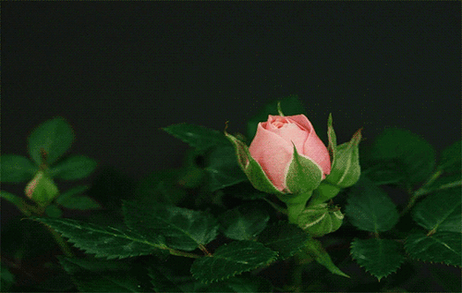
THANKS TO ALL

